Slide 1

__L1n__w@tch
Ten Quiz

Slide 2
__L1n__w@tch
Question 1
Data compression is often used in data storage and transmission. Suppose you want to use data compression in conjunction with encryption. Does it make more sense to:
Compress then encrypt.
The order does not matter -- neither one will compress the data.
The order does not matter -- either one is fine.
Encrypt then compress.
解析：
加密后数据变成随机的一串比特流，不利于压缩。

Slide 3
__L1n__w@tch
Question 2
Let G:{0,1}^{s}→{0,1}^{n} be a secure PRG. Which of the following is a secure PRG (there is more than one correct answer):
G′(k)=G(k)∥∥0 (here ∥∥ denotes concatenation)
G′(k)=G(k)∥∥G(k)
G′(k)=G(k)[0,…,n−2]
G′(k1,k2)=G(k1)∥∥G(k2)
G′(k)=G(0)
G′(k)=reverse(G(k))
1982年，姚期智给出了一个优雅非凡的定理，人们认同了这个定理。
实际上逆命题也是成立的。
一个不可预测的生成器，那么你就不能根据前I位预测第I+1位。
I取任何值都成立，则这个生成器是安全的。
解析：
利用可预测与不可预测性来区分安全PRG和不安全PRG。

Slide 4
__L1n__w@tch
Question 3
Let G:K→{0,1}^{n} be a secure PRG. Define G′(k1,k2)=G(k1)⋀G(k2) where ⋀ is the bit-wise AND function. Consider the following statistical test A on {0,1}^{n}:
A(x) outputs LSB(x), the least significant bit of x.
What is AdvPRG[A,G′] ? You may assume that LSB(G(k)) is 0 for exactly half the seeds k in K.
解析：
语义安全的公式：
Adv[A, G'] = |Pr[A(G')=1] - Pr[A(r)=1]|
= | Pr[LSB(G1 and G2) = 1] - 1/2 |
= |1/4 – 1/2|
= 1/4

Slide 5
__L1n__w@tch
Question 4
Let (E,D) be a (one-time) semantically secure cipher with key space K={0,1}ℓ. A bank wishes to split a decryption key k∈{0,1}ℓ into two pieces p1 and p2 so that both are needed for decryption. The piece p1 can be given to one executive and p2 to another so that both must contribute their pieces for decryption to proceed.
The bank generates random k1 in {0,1}ℓ and sets k′1←k⊕k1. Note that k1⊕k′1=k. The bank can give k1 to one executive and k′1 to another. Both must be present for decryption to proceed since, by itself, each piece contains no information about the secret key k (note that each piece is a one-time pad encryption of k).
Now, suppose the bank wants to split k into three pieces p1,p2,p3 so that any two of the pieces enable decryption using k. This ensures that even if one executive is out sick, decryption can still succeed. To do so the bank generates two random pairs (k1,k′1) and (k2,k′2) as in the previous paragraph so that k1⊕k′1=k2⊕k′2=k. How should the bank assign pieces so that any two pieces enable decryption using k, but no single piece can decrypt?

Slide 6
__L1n__w@tch
Question 4
p1=(k1,k2),p2=(k′1,k′2),p3=(k′2)
p1=(k1,k2),p2=(k′1),p3=(k′2)
p1=(k1,k2),p2=(k1,k2),p3=(k′2)
p1=(k1,k2),p2=(k′1,k2),p3=(k′2)
p1=(k1,k2),p2=(k2,k′2),p3=(k′2)
解析：
k1' = k xor k1
k2' = k xor k2
题目要求任意两个人都能计算得到k，所以只要任意两个人中能够有（k1, k1’）或（k2，k2’）即可

Slide 7
__L1n__w@tch
Question 5
Let M=C=K={0,1,2,…,255} and consider the following cipher defined over (K,M,C):
E(k,m)=m+k(mod256);D(k,c)=c−k(mod256) .
Does this cipher have perfect secrecy?
解析：
Yes。
We aim to show that for all c in C, m1 in M, m2 in M:
P[E(k,m1) = c] = P[E(k,m2) = c]（完善保密性要求）
so we simply compute, for any m in M
P[E(k, m) = c] = P[m + k mod 256 == c] = P[c - m mod 256 == k] = 1/256
给定k,m1和k,m2，它们产生c的概率都是1/256
So the cipher has perfect secrecy.

Slide 8
__L1n__w@tch
Question 6
Let (E,D) be a (one-time) semantically secure cipher where the message and ciphertext space is {0,1}n. Which of the following encryption schemes are (one-time) semantically secure?
E′(k,m)=E(k,m)∥∥LSB(m)
E′(k,m)=E(k,m)∥∥k
E′(k,m)=E(0^{n},m)
E′(k,m)=reverse(E(k,m))
E′(k,m)=compute c←E(k,m) and output c∥∥c (i.e., output c twice)
E′( (k,k′), m)=E(k,m)∥∥E(k′,m)
通过最后一位判断
泄漏密钥
泄漏密钥
解析：
判断标准：攻击者是否能区分实验0和实验1。

Slide 9
__L1n__w@tch
Question 7
Suppose you are told that the one time pad encryption of the message "attack at dawn" is 6c73d5240a948c86981bc294814d (the plaintext letters are encoded as 8-bit ASCII and the given ciphertext is written in hex). What would be the one time pad encryption of the message "attack at dusk" under the same OTP key?
解析：

Slide 10
__L1n__w@tch
Question 8
The movie industry wants to protect digital content distributed on DVD’s. We develop a variant of a method used to protect Blu-ray disks called AACS.
Suppose there are at most a total of n DVD players in the world (e.g. n=232). We view these n players as the leaves of a binary tree of height log2n. Each node in this binary tree contains an AES key ki. These keys are kept secret from consumers and are fixed for all time. At manufacturing time each DVD player is assigned a serial number i∈[0,n−1]. Consider the set of nodes Si along the path from the root to leaf number i in the binary tree. The manufacturer of the DVD player embeds in player number i the keys associated with the nodes in the set Si. A DVD movie m is encrypted as
E(kroot,k)∥∥E(k,m)
where k is a random AES key called a content-key and kroot is the key associated with the root of the tree. Since all DVD players have the key kroot all players can decrypt the movie m. We refer to E(kroot,k) as the header and E(k,m) as the body. In what follows the DVD header may contain multiple ciphertexts where each ciphertext is the encryption of the content-key k under some key ki in the binary tree.
Suppose the keys embedded in DVD player number r are exposed by hackers and published on the Internet. In this problem we show that when the movie industry distributes a new DVD movie, they can encrypt the contents of the DVD using a slightly larger header (containing about log2n keys) so that all DVD players, except for player number r, can decrypt the movie. In effect, the movie industry disables player number r without affecting other players.
As shown below, consider a tree with n=16 leaves. Suppose the leaf node labeled 25 corresponds to an exposed DVD player key. Check the set of keys below under which to encrypt the key k so that every player other than player 25 can decrypt the DVD. Only four keys are needed.

Slide 11
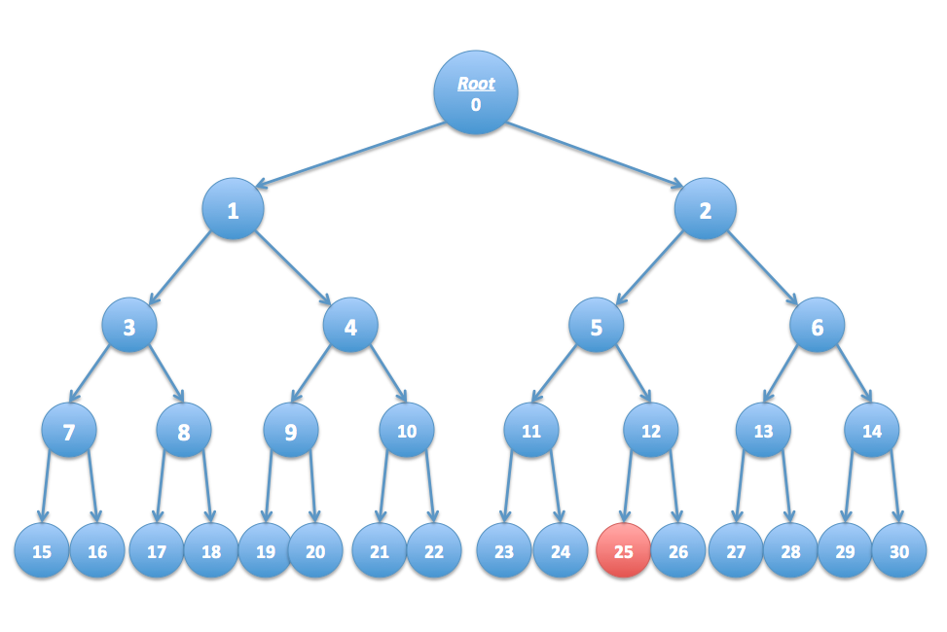
__L1n__w@tch
解析：
We need to encrypt the key with 1, 6, 11, and 26 so that (25) does not have
a way to decrypt the key, but everybody else does.

Slide 12
__L1n__w@tch
Question 9
Continuing with the previous question, if there are n DVD players, what is the number of keys under which the content key k must be encrypted if exactly one DVD player's key needs to be revoked?
√n
n/2
n−1
2
log₂n
解析：
We need log(n) keys because we have to encrypt the sibling, parent's
sibling, parent's parent's sibling, and so on up the log(n) levels
二叉树的高度即log₂n

Slide 13
__L1n__w@tch
Question 10
Continuing with question 8, suppose the leaf nodes labeled 16, 18, and 25 correspond to exposed DVD player keys. Check the smallest set of keys under which to encrypt the key k so that every player other than players 16,18,25 can decrypt the DVD. Only six keys are needed.

Slide 14
__L1n__w@tch
解析：
We must encrypt k under the leaf siblings' keys 15, 17, and 26 as well as the
nodes 11, 6, and 4.

Slide 15
__L1n__w@tch
In the end
T
H
A
N
K
Y
0
U

